Slide 1
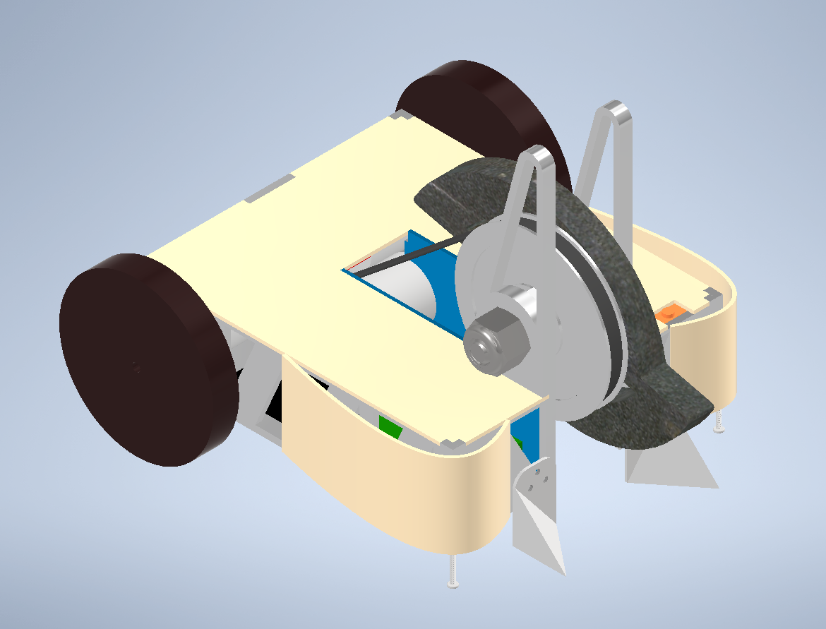
Insaniti
Notes:
Just a title slide, you can fancify the background, etc.

Slide 2
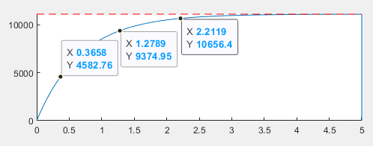
Weapon Calculations
General Robot Stats
Stat | Value | Unit
Weapon to Motor Ratio | 2.75”:1.48” = 1.86 | N/A
Weapon moment of inertia | 2.853 | lb/in²
Max RPM | 11100 | rev/min
Max kinetic energy | 2700 | J
Spin up time | 1.6535 | s
Stat | Value | Unit
Total Weight | 3.179 | lbs
Weapon Assembly Weight | 1.4 | lbs
Minimum weapon to ground clearance | 0.25 | in
Notes:
This is your main introductory slide, introduce the robot at a top level and discuss its main characteristics, like those in the table. You will explain more about the stats in later slides

Slide 3
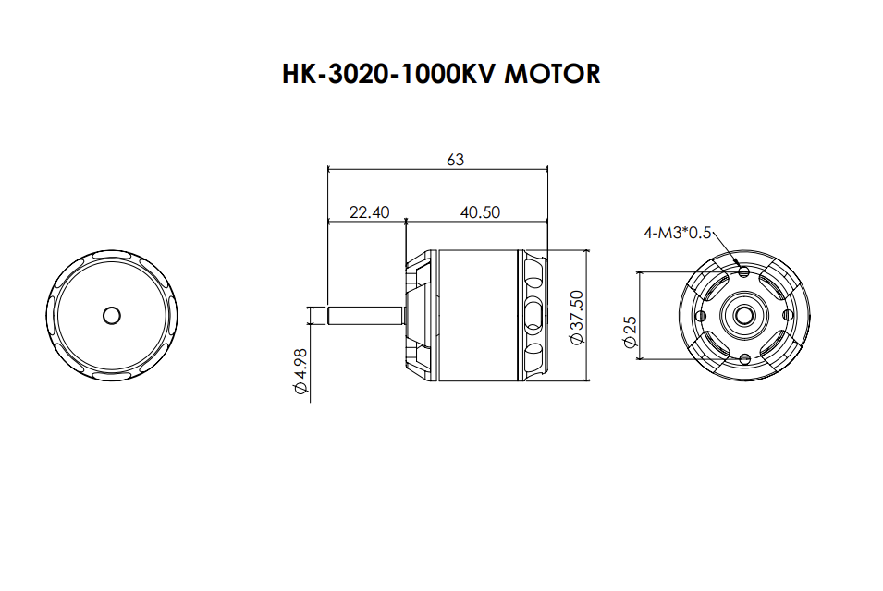
Motor
Scorpion HK-3020-1000KV - Scorpion Power System (scorpionsystem.com)
1.4764” diameter
0.030 Ohms
kV = 1000
Notes:
Now we dive right into the design review. From that initial slide, move into talking about the weapon at a top level, discussing how the parts mesh together to form a complete unit. Talk about its form and design, and then move into describing the calculation you did on this subsystem to validate your design (IE weapon deformation, spinup, etc). Once you’ve quickly talked about all of this, open the floor up to our normal design review style where people start asking questions, etc. Once that concludes for the weapon, move to the next slide and repeat the same general process of talking about the design of the subsystem at a high level, the calculations behind it, and then opening up the floor.

Slide 4

Weapon Assembly
Tool Steel Weapon
0.996 lbs
0.5 in thickness
5.5 in max diameter
Aluminum Pulley
3” diameter
2.75” groove diameter
0.281” groove thickness
x2 5/32” - 1” Screws
x2 5/32” Steel Thin Hex Nuts
Ball Bearings
0.5” inner diameter
Total Mass: 1.204 lbs
Moment of Inertia: 2.853 lbs/in²
Notes:
Now we dive right into the design review. From that initial slide, move into talking about the weapon at a top level, discussing how the parts mesh together to form a complete unit. Talk about its form and design, and then move into describing the calculation you did on this subsystem to validate your design (IE weapon deformation, spinup, etc). Once you’ve quickly talked about all of this, open the floor up to our normal design review style where people start asking questions, etc. Once that concludes for the weapon, move to the next slide and repeat the same general process of talking about the design of the subsystem at a high level, the calculations behind it, and then opening up the floor.

Slide 5
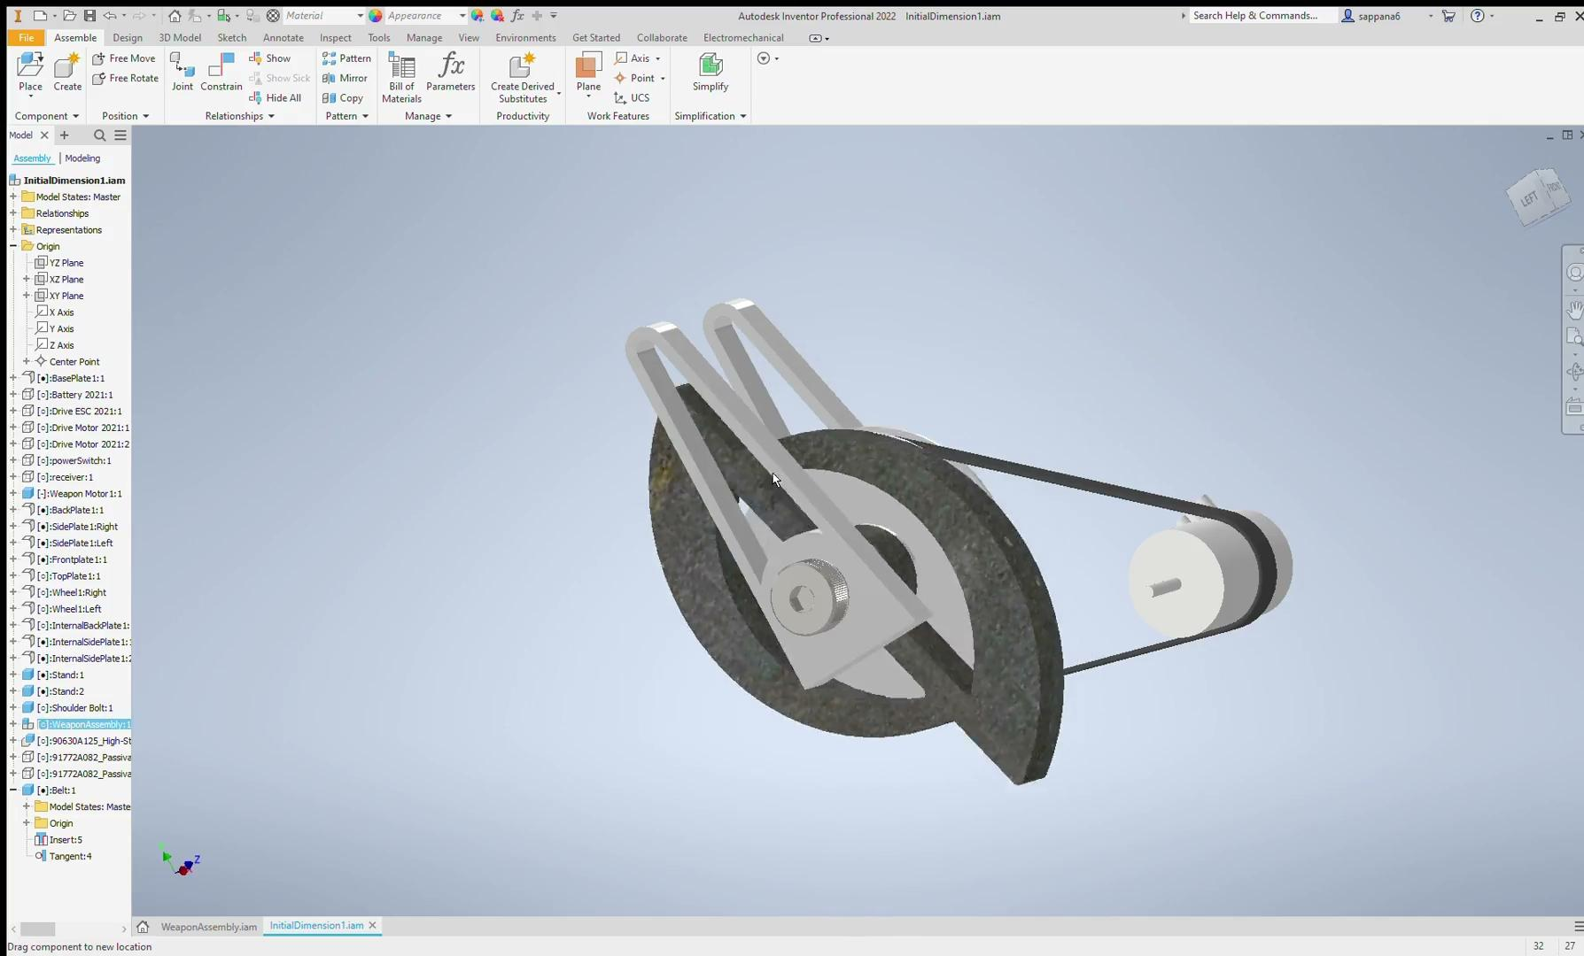
Weapon Assembly Connecting To Chassis
0.5” diameter Shoulder Bolt
0.5” Nylon Locking Nut
Weapon Holder
0.25” thickness
4” max height
Rubber Belt
Weapon Motor:
1.4764” diameter
0.030 Ohms
kV = 1000
Notes:
Now we dive right into the design review. From that initial slide, move into talking about the weapon at a top level, discussing how the parts mesh together to form a complete unit. Talk about its form and design, and then move into describing the calculation you did on this subsystem to validate your design (IE weapon deformation, spinup, etc). Once you’ve quickly talked about all of this, open the floor up to our normal design review style where people start asking questions, etc. Once that concludes for the weapon, move to the next slide and repeat the same general process of talking about the design of the subsystem at a high level, the calculations behind it, and then opening up the floor.

Slide 6
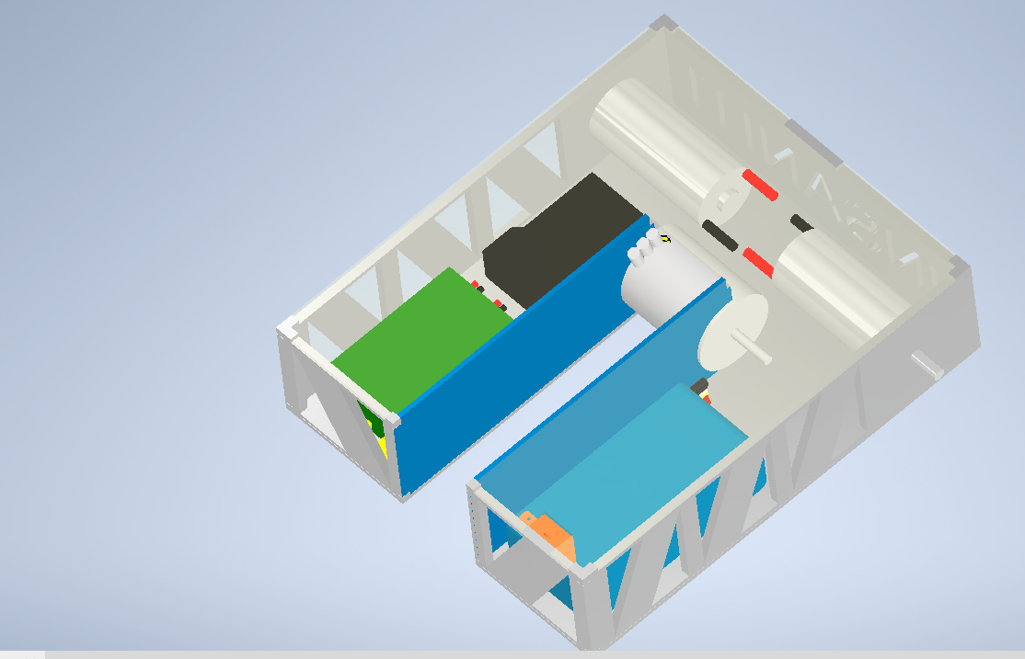
Chassis
List of parts
2x Side plates
2x Front plates
1x Back plate
1x Top plate
1x Base plate
Common electronic parts
Placeholder weapon motor
Weight:1.42 lbs
Height:1.625 inch
Width:5.25 inch
Length:6.25 inch
Notes:
Here is the chassis we have designed for out robot. The screen depicts the chassis with the top plate invisible and the dimensions and weight of the chassis are shown as well. Our main design goals was of course to be able to fit all the electronic components but the weapon as well. Since we are working with a vertical spinner closely mount to our robot, we had a wide gap that we made as long as possible in the middle of our chassis to allow for a larger weapon. Our electronics are split between the gap in the chassis but we expect to wire them behind the drivetrain motors in the back. Because our electronics is housed in two locations of our chassis we can unevenly distribute weight between the left and right sides of the chassis to counteract the force outputted from our weapon motor. So whatever side our robot turns to as a result of the weapon motor spinning we can make the other side heavier in hopes to be able to have a little more control.
Every plate besides the top plate is set to aluminum with a thickness of ⅛ inches to make up for a lack of armor outside of the chassis.The top plate will be a dense plastic as we expect to be hit less from the top than from our side and making it plastic will save some weight. Every plate depicted has a puzzle fit into the other plates and we plan on creating tapped holes in each plate and screw them together. An important aspect of our robot design is invertibility and as a result we designed our chassis to be a lower height than the diameter of our wheels.
We also have these internal side plates that serve two purposes. They completely close off our electronics and they create a space to mount and secure our weapon motor. Once we know the specifications of the weapon motor we can create mounting brackets between the screw holes on the motor and the internal plates.

Slide 7
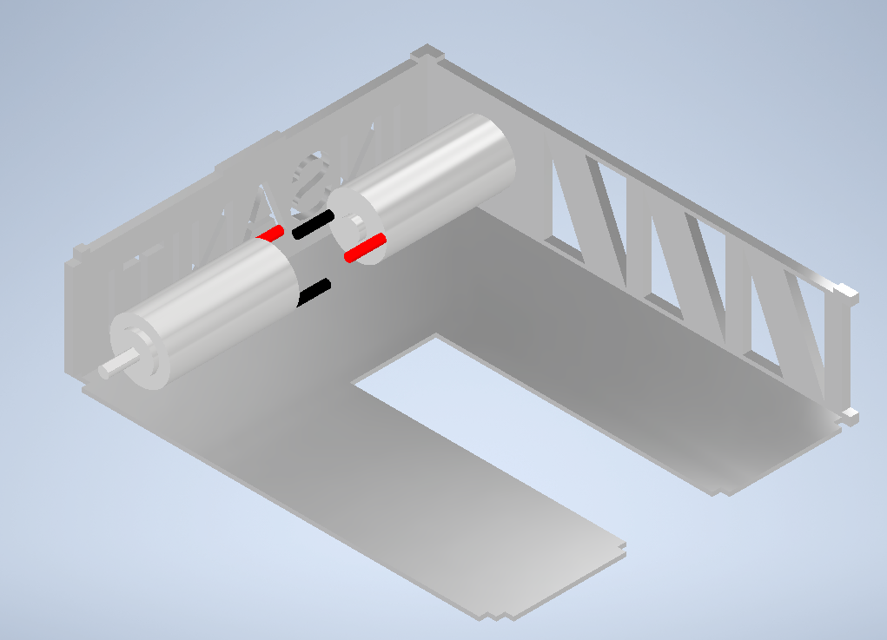
Drive Train
2 Drive motors
2 mounting brackets (not included)
Weight
Total: ~.5 lbs
0.161 lbs per motor
Likely ~.1 pound for the brackets

Slide 8
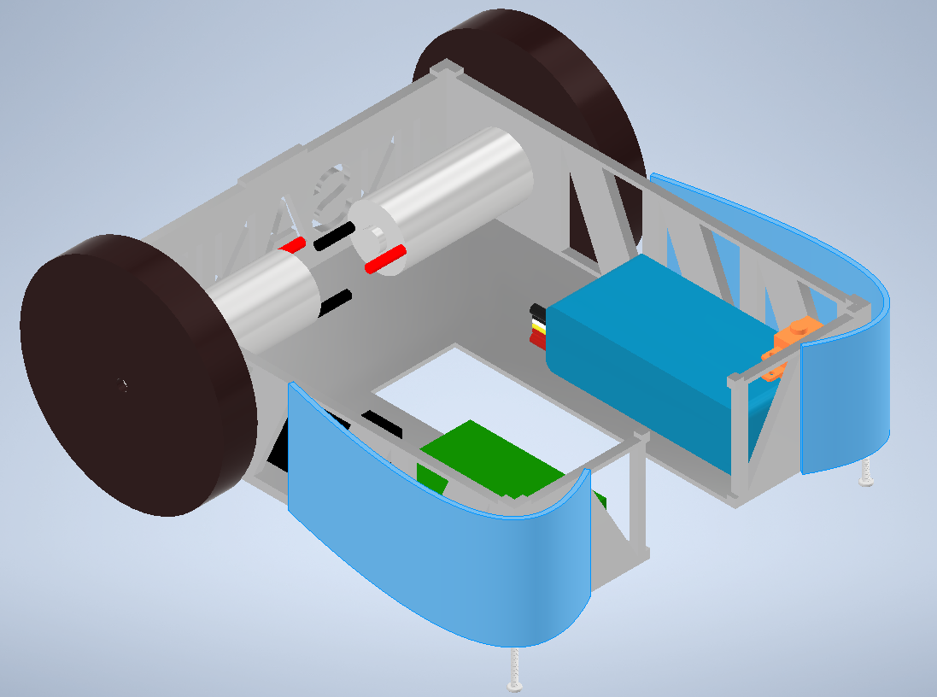
Armor
2 armor plates
4 bolts (not included)
Weight
Total: ~0.032
0.016 lbs per plate
Notes:
Talk about current lack of armor, why we don’t have a lot(ie we really only need it for the wheels) and current plan for armor(wedges and wheel covers)

Slide 9
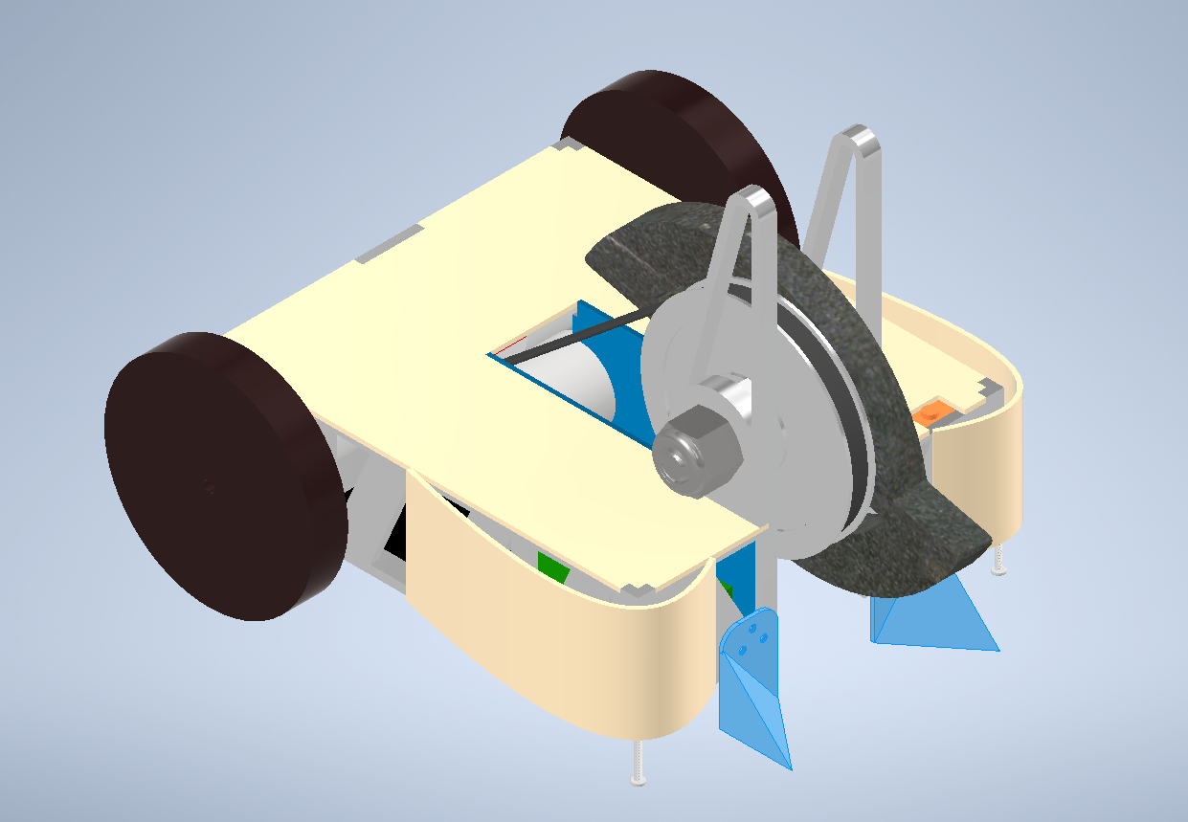
Armor
2 Aluminum Sheets
6 Rivets
Weight
Total: 0.035 lbs
Notes:
Talk about current lack of armor, why we don’t have a lot(ie we really only need it for the wheels) and current plan for armor(wedges and wheel covers)

Slide 10
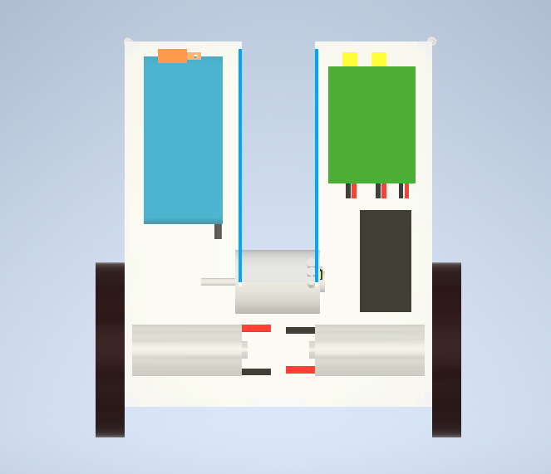
Electronics
Notes:
At this point, discuss the general layout of electronics and how they entire system is hooked up. Start at the batteries and talk about the flow of power to each unit (ex. The battery then leads into the first switch, which splits off into…). Open the floor up to questions as usual.
Mention

Slide 11
Can you answer all of these questions confidently?
Is your robot at weight with wires?
Is the clearance between your weapon and the ground sizeable enough?
Do your wheels have enough clearance to rotate and touch the ground?
Are your holes fitting nicely in the thickness of material they are in?
Does your motor mount interface with slots so the belt can be tensioned?
Are the inner and outer races of all bearings able to move freely?
Do all your motor shafts stick far enough out into wheel hub?
Does your CAD have the belt factored in?
Do your pulleys have slots for your belts?
Do all cutouts have fillets?
Do all cutouts and members have a good thickness?
How are the wires being placed all around your robot so they don’t touch spinning things?
How are you mounting your electronics inside your robot?
Do you know what material each part will be made of?

